Slide 1

Guided tour i-SUSTAIN.
17-09-2019
Erik Lundsgaard

Slide 2
Organizing of Kalundborg Bioenergi
Leverandører
Biogasanlæg
Aftager
Supplier of Novoslam
(Novozymes)
Bigadan
100 %
Ørsted
0 %
Plant Breeders ”1”
(lokaliseret på Sydsjælland)
Supplier of Yeast cream (Novo Nordisk)
Kalundborg Bioenergi A/S
Plant Breeders ”2”
(Returkørsel fra NZFU)
Others supplier
Bioman mm.
Ørsted Energy
(Injicere biogas på naturgasnettet)
Operations manager
Bigadan

Slide 3
Overall tasks & time-line
LoI & Feasibility Study:
Methane potential & dewatering tests
Approvals from authorities
Disposal of digested biomass
Agreements between the parties
LoI & Feasibility Study
Plant Construction
Commercial Operation
July 2015
Januray 2016
July 2016
Januray 2017
July 2017
Januray 2018
July 2018
Januray 2019
July 2019

Slide 4
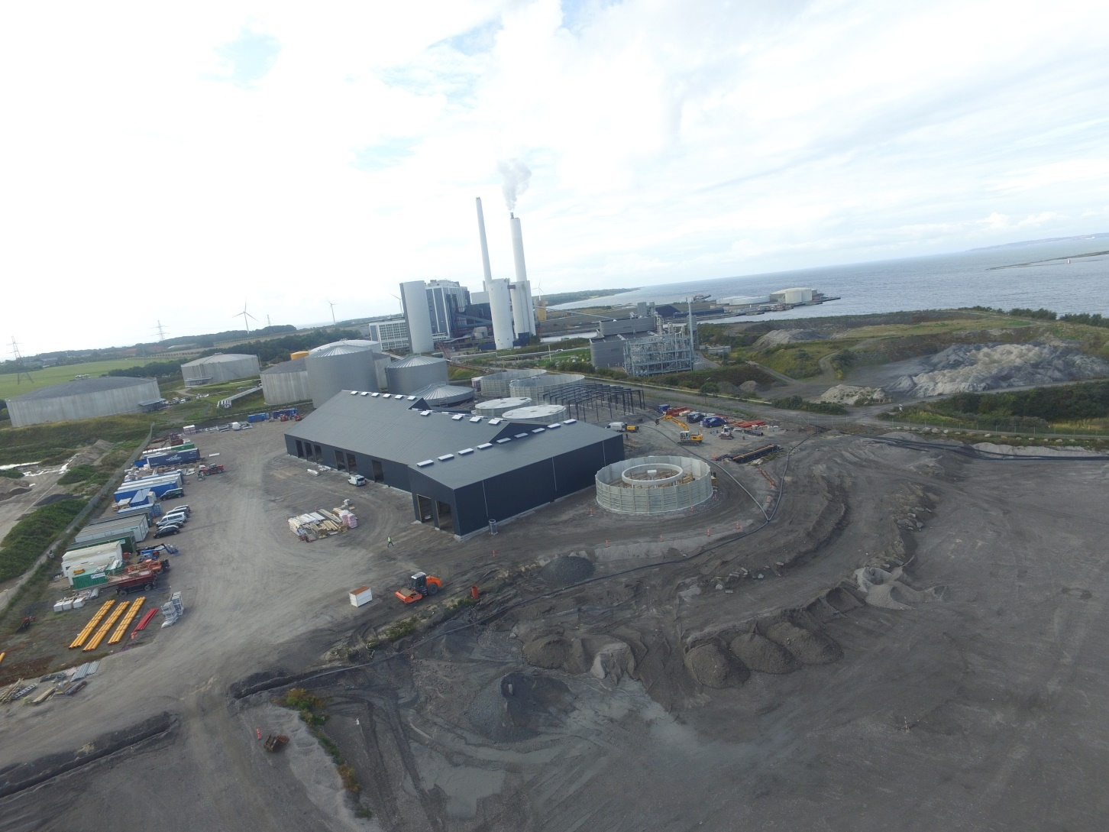
Construction status SEP 19. 2017

Slide 5
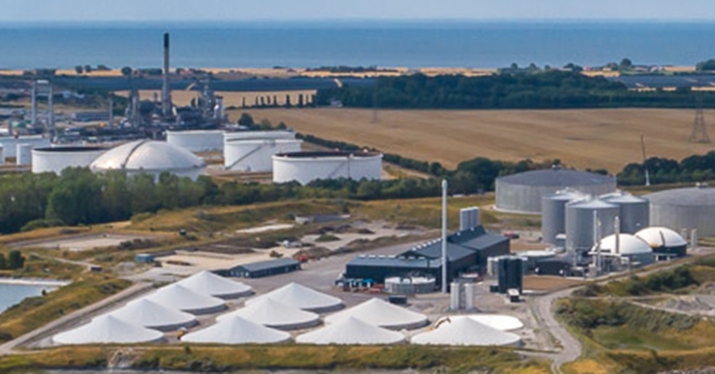
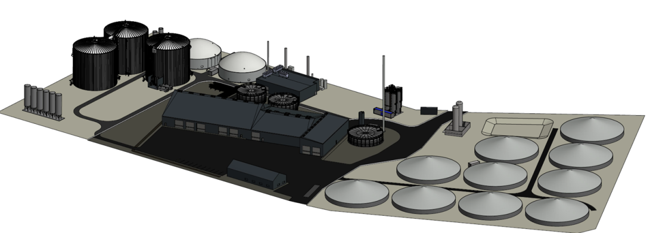
Kalundborg Bioenergi, Denmark
    Operation since April 2018
    Owned 100 % by Bigadan
    Capacity:
    400.000 t/year
    Biomass:
    Residual product from Novo Nordic and Novozymes
    Biogas production:
    18 million m³ methane/year
    Biogas utilisation:
    Gas upgrading and injection into natural gas grid
    Energy sales:
    180 GWh/year - natural gas injection

Slide 6
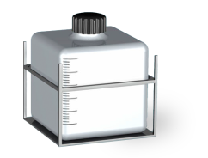
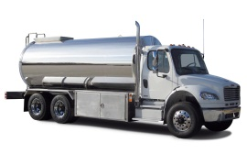
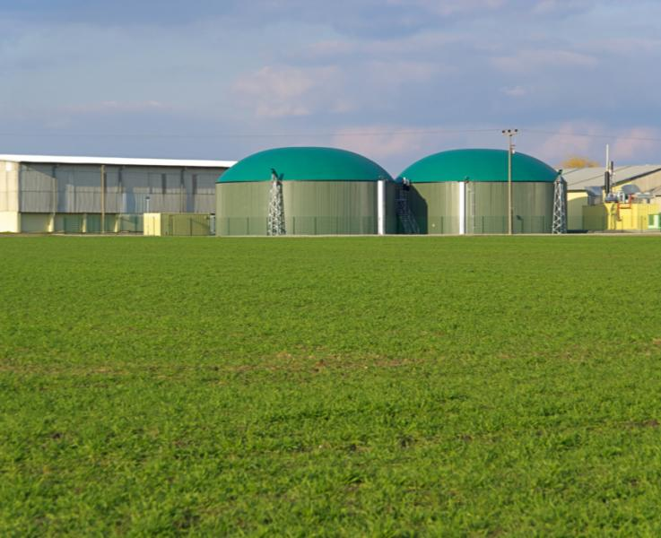
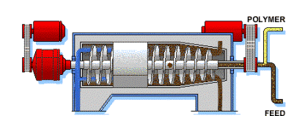
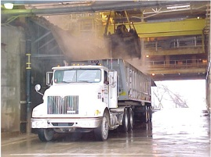
Future biomass flow
BIOMASS
DEWATERING
TRANSPORTATION
ANAEROBIC DIGESTION
BIOMASS
FROM NNKA
68,000 ton/y
DM = 16%
287,500 ton/y
42.000 ton TS (14,6% TS)
TN = 6.1 g/L
TP = 3.3 g/L
If needed, additional dilution liquid can be collected at NZKA
Gas production =
8.40 mill Nm3 CH4/y
75,000 ton/y
DM = 4%
BIOMASS FROM NZFU
BIOMASS FROM NZKA PRODUCTION AND WASTE WATER TREATMENT PLANT
150,500 ton/y
DM = 19%
FARMERS
(1 OR 2 FRACTIONS)

Slide 7
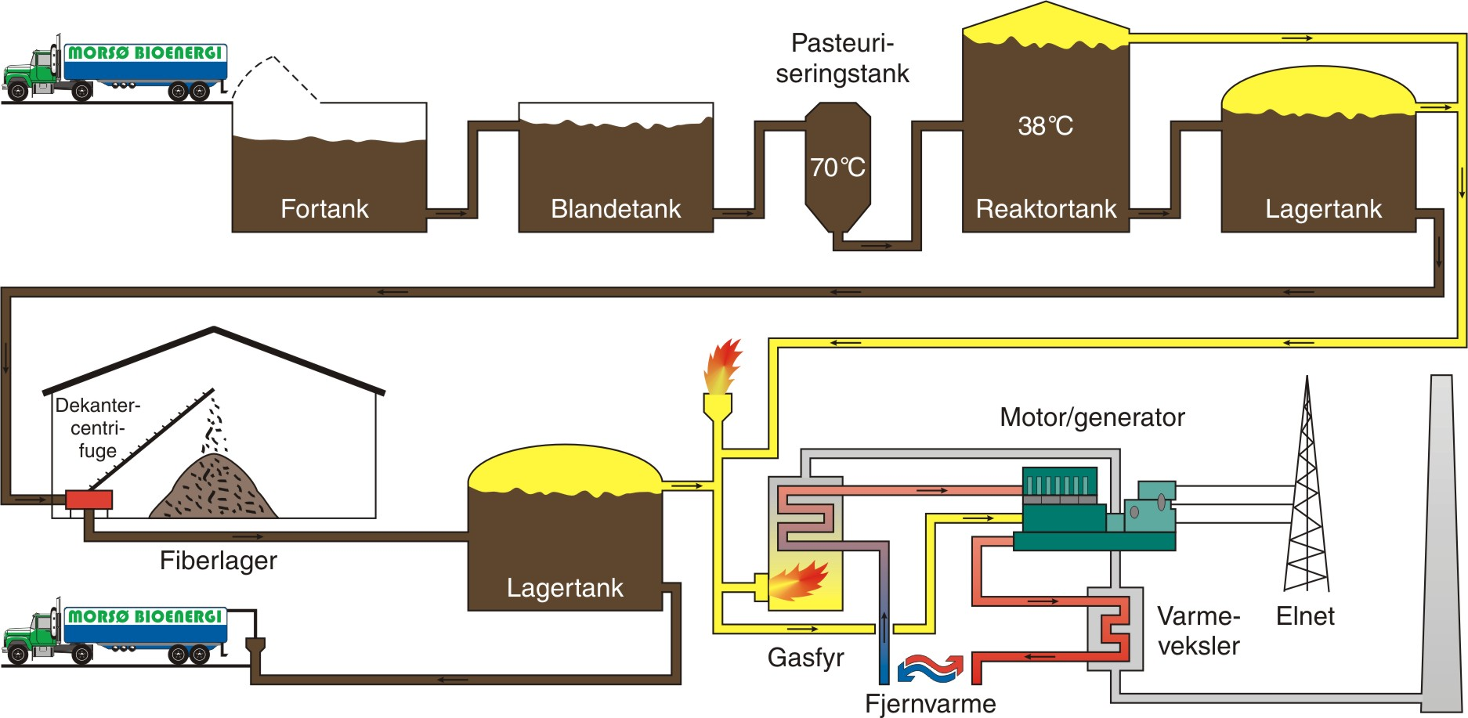
How does biogas work?

Slide 8
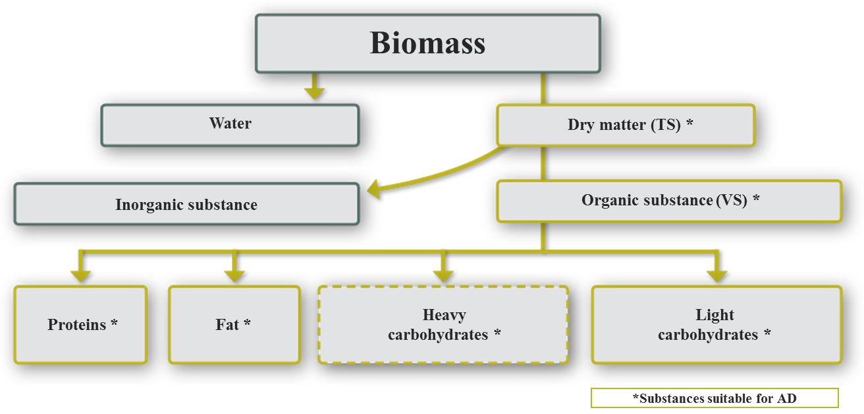
Biomass composition

Slide 9
Kalundborg Bioenergi A/S
Area 52500 M2

Slide 10
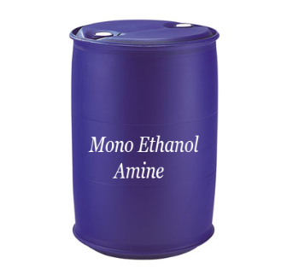
30% lye

Slide 11
Kalundborg Bioenergi A/S

Slide 12
Kalundborg Bioenergi A/S
Thank you for your attention.
Manager
Erik Lundsgaard

